Slide 1
Right of way users meeting 2025
April 2025

Slide 2
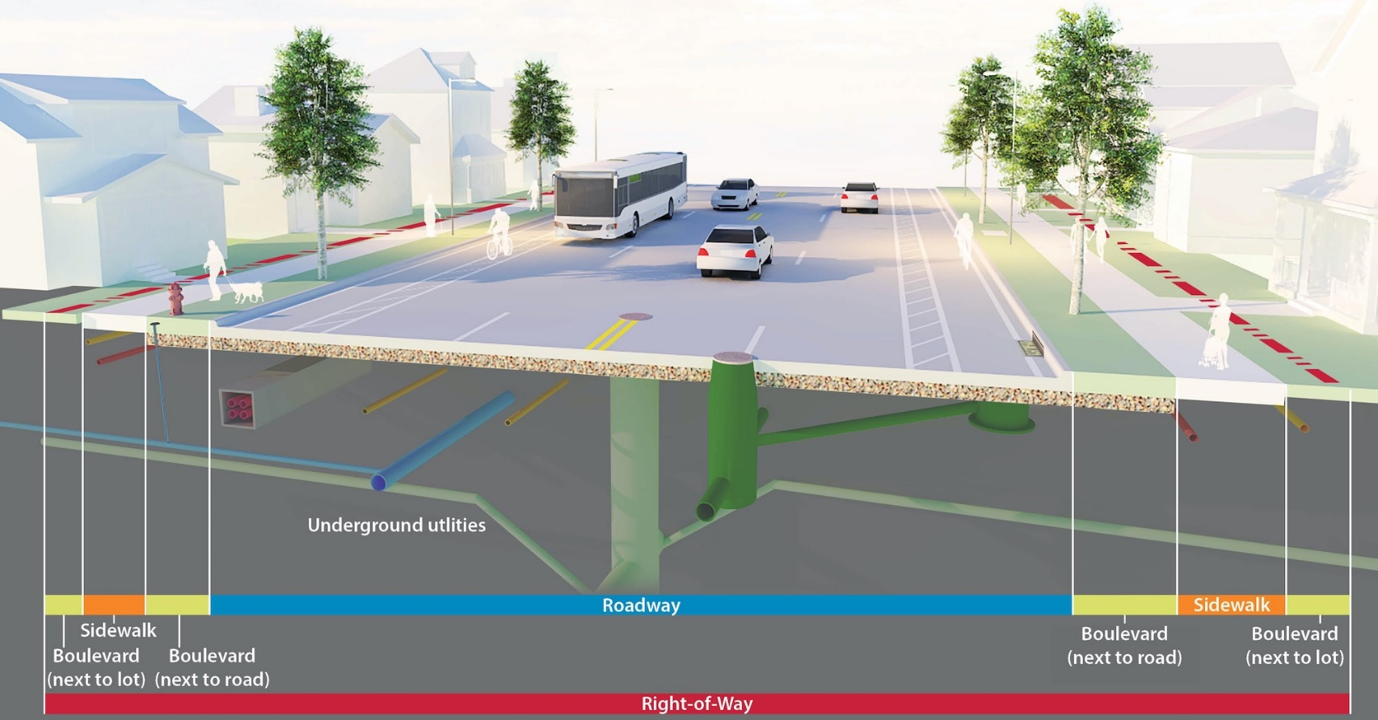

Slide 3
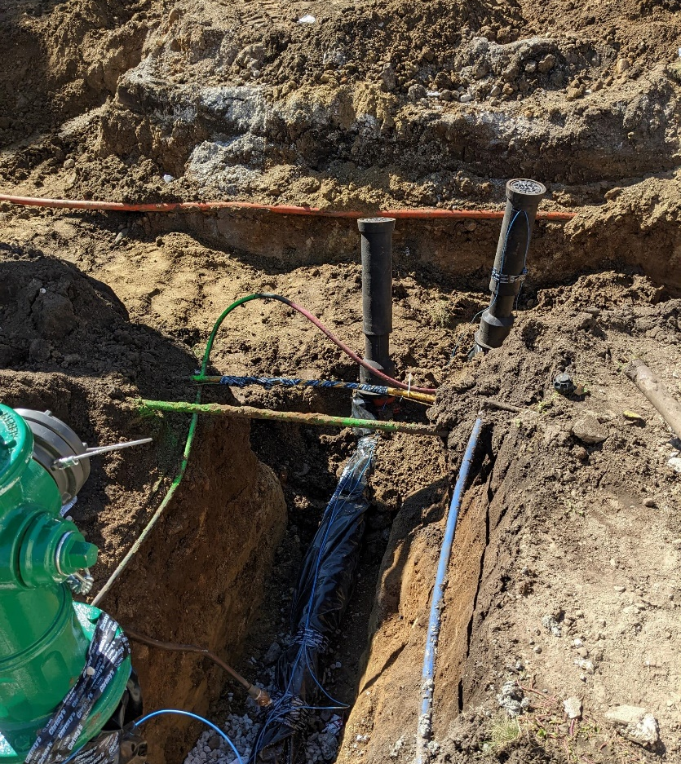
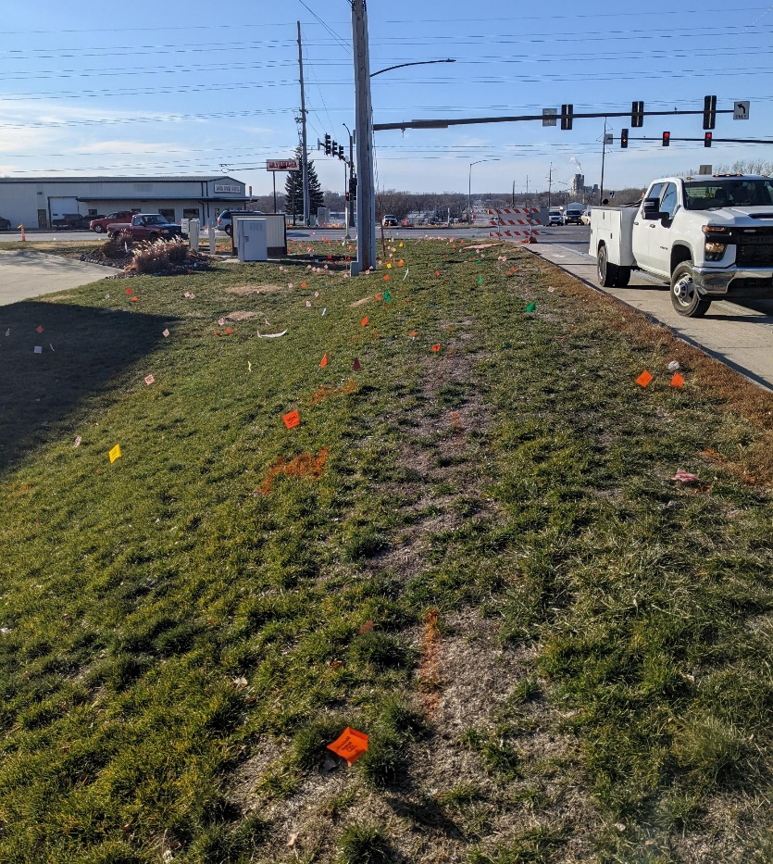

Slide 4
registration
Roway Permit System: https://ames.ia.roway.net/
City of Ames Utility Maps: https://www.cityofames.org/government/departments-divisions-i-z/public-works/gis/public-works-utility-information
City of Ames Contact: Noel Steckelberg, 515-239-5436, noel.steckelberg@cityofames.org
Register annually
Update Contact Information
Update Certificate of Liability (Certificate of Insurance)
  The City of Ames MUST BE included as additional insured on the general liability policy or the permit CANNOT be approved
  The policy must have coverage up to at least $1,000,000
Registration of Iowa “One Call” System

Slide 5
Right of way ordinance chapter 22A
https://www.cityofames.org/government/departments-divisions-i-z/public-works/right-of-way-management
Standard regulations that apply to all work within ROW
  Ames 2025 Supplemental Specifications Coming Soon
  Most current edition of SUDAS (2025)
  MUTCD (standard traffic control option)
  IDOT permit required when working in the IDOT ROW

Slide 6
Roway Application
Apply-Obtain Permits
    Register as a ROW User
    Apply for Permit
    Upload drawings and/or other required documents
    Begin –Ending Dates
    All Actions will require a City of Ames approval. Automated notifications will be sent
    Pre-ROW meetings may be required, especially for large projects
    Notify the City when the work is complete

Slide 7
ROW Recommended practices during work
Safety: Protect all excavations and obstructions as per the Manual of Uniform Traffic Control Devices (MUTCD)
Pavement Core holes: Please notify and include as part of the permit application of any necessary pavement core holes. Temporarily fill pavement core holes with granular material immediately after use and maintain at grade if settlement occurs.
Utility Potholes (not pavement): Fill to within 8”. Then, place topsoil and seed.
Traffic/Pedestrian Control: Refer to standard traffic control options included in the ROW Management Webpage. If the options are applied and approved, the options shall be implemented.
Have your ROW Permit available at work site.

Slide 8
Row permit closing and follow-up
  Contact Scott Miller to coordinate an onsite inspection to ensure that ROW restoration was completed properly
  Finish grade and seed disturbed areas as soon as possible. Seed mix match vegetation. Must follow-up to ensure vegetation establishment
  Upload progress pictures and as-built drawings

Slide 9
Common ROW issues
  Where a cut or disturbance is made by a right-of-way user to a section of a street or a sidewalk paving, rather than replacing only the area cut, the right-of-way user shall replace the full width of the existing sidewalk or street paving and the full length of the section or sections cut, a section being that area marked by expansion joints or scoring, or as directed by the City.
  Beware of City Fiber present in ROW’s. Fibers will be located when requests are entered through the Iowa One Call System. Very important: No splicing
  Pavement potholing within a roadway must be repaired with a 4’x4’ section of pavement meeting surrounding pavement and subbase depth
  Ensure that nearby residents/businesses are notified of the work that is being conducted BEFORE work is conducted

Slide 10
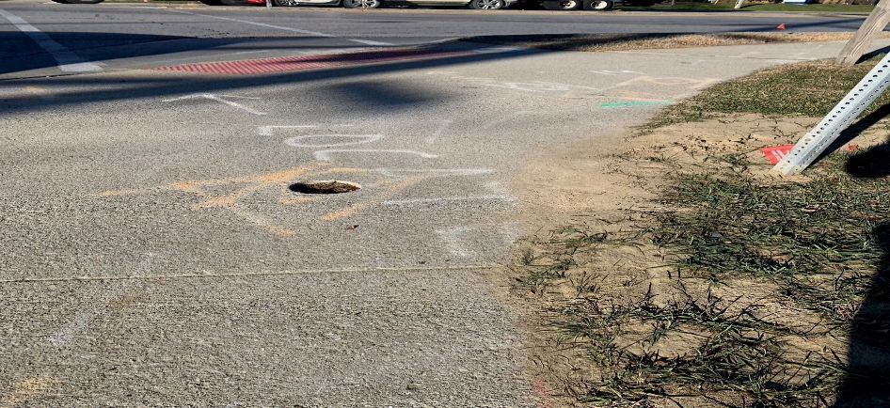
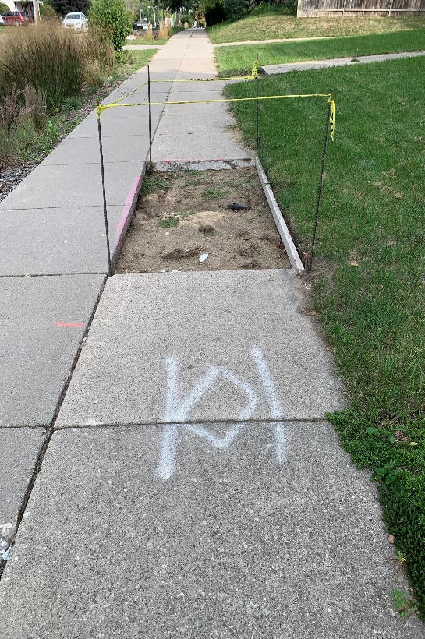
Examples

Slide 11
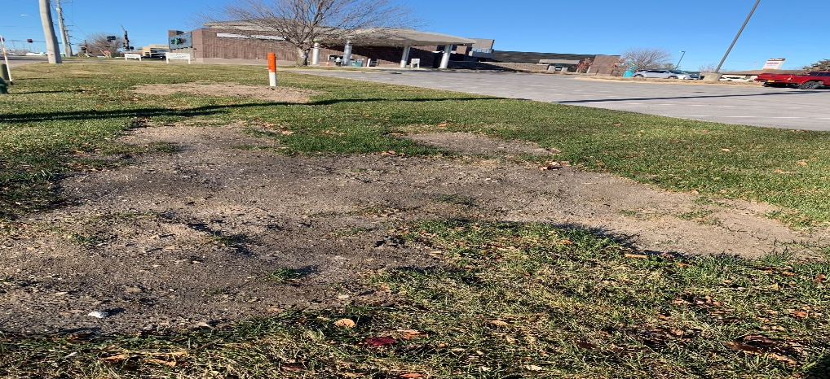
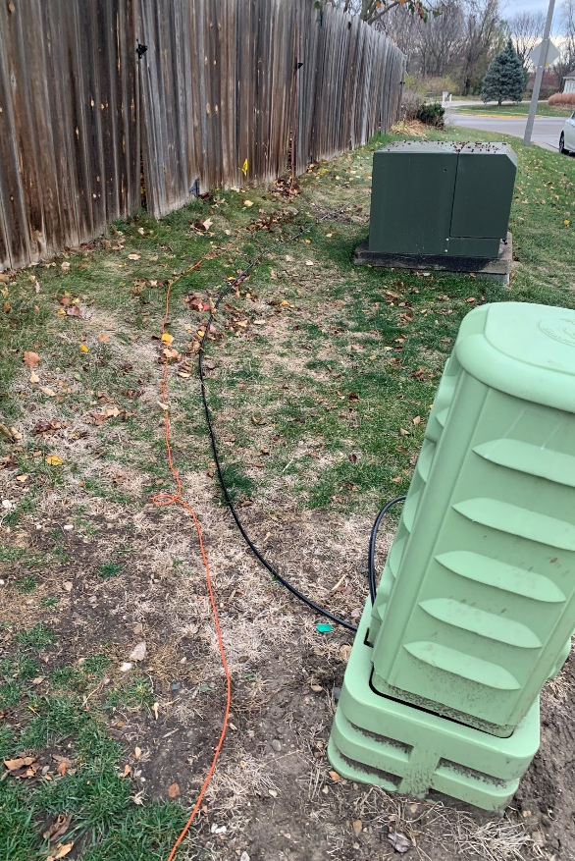
Examples

Slide 12
ROW changes
  Noel Steckelberg to replace Dean Sayre as ROW permit administrator.
    Phone: 515-239-5436
    Email: noel.steckelberg@cityofames.org
  After permit approval, contact Scott Miller before ANY WORK is conducted within the ROW
    Phone: 515-203-0793
    Email: Scott.Miller@cityofames.org
  Lack of communication prior to starting work may result in a fine
    $500 for the first offense
    $750 for the second offense
    Third offense results in the company/individual that submitted the permit not being allowed to submit any new ROW permits and any other current, open permits being revoked.

Slide 13
ROW changes
  Door hangers are now required for public notification.
  Information to include on door hanger:
    Project Description
    Roads/areas of project
    ROW registrant contact information
    Contractor contact information
    Location of ROW or easement on properties
  Other useful forms of notifications to also include:
    HOA notification
    Facebook
    Instagram

Slide 14
City of Ames Operations & Utility ROW Managers
  Justin Clausen : Operations Manager
  Mark Imhoff : Electric
  Dale Weber/Kendel Miller :
    Water and Sewer
  Dave Cole/Erick Hill
    Streets and Storm Sewer
  Public Works Inspectors
    Scott Shepherd
    Scott Miller
    Jesus Campa
    Jared Beckman

Slide 15
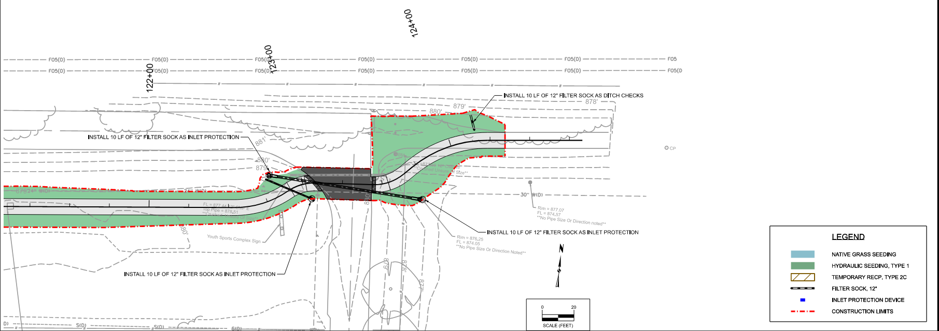
Skunk River Shared Use Path Expansion

Slide 16
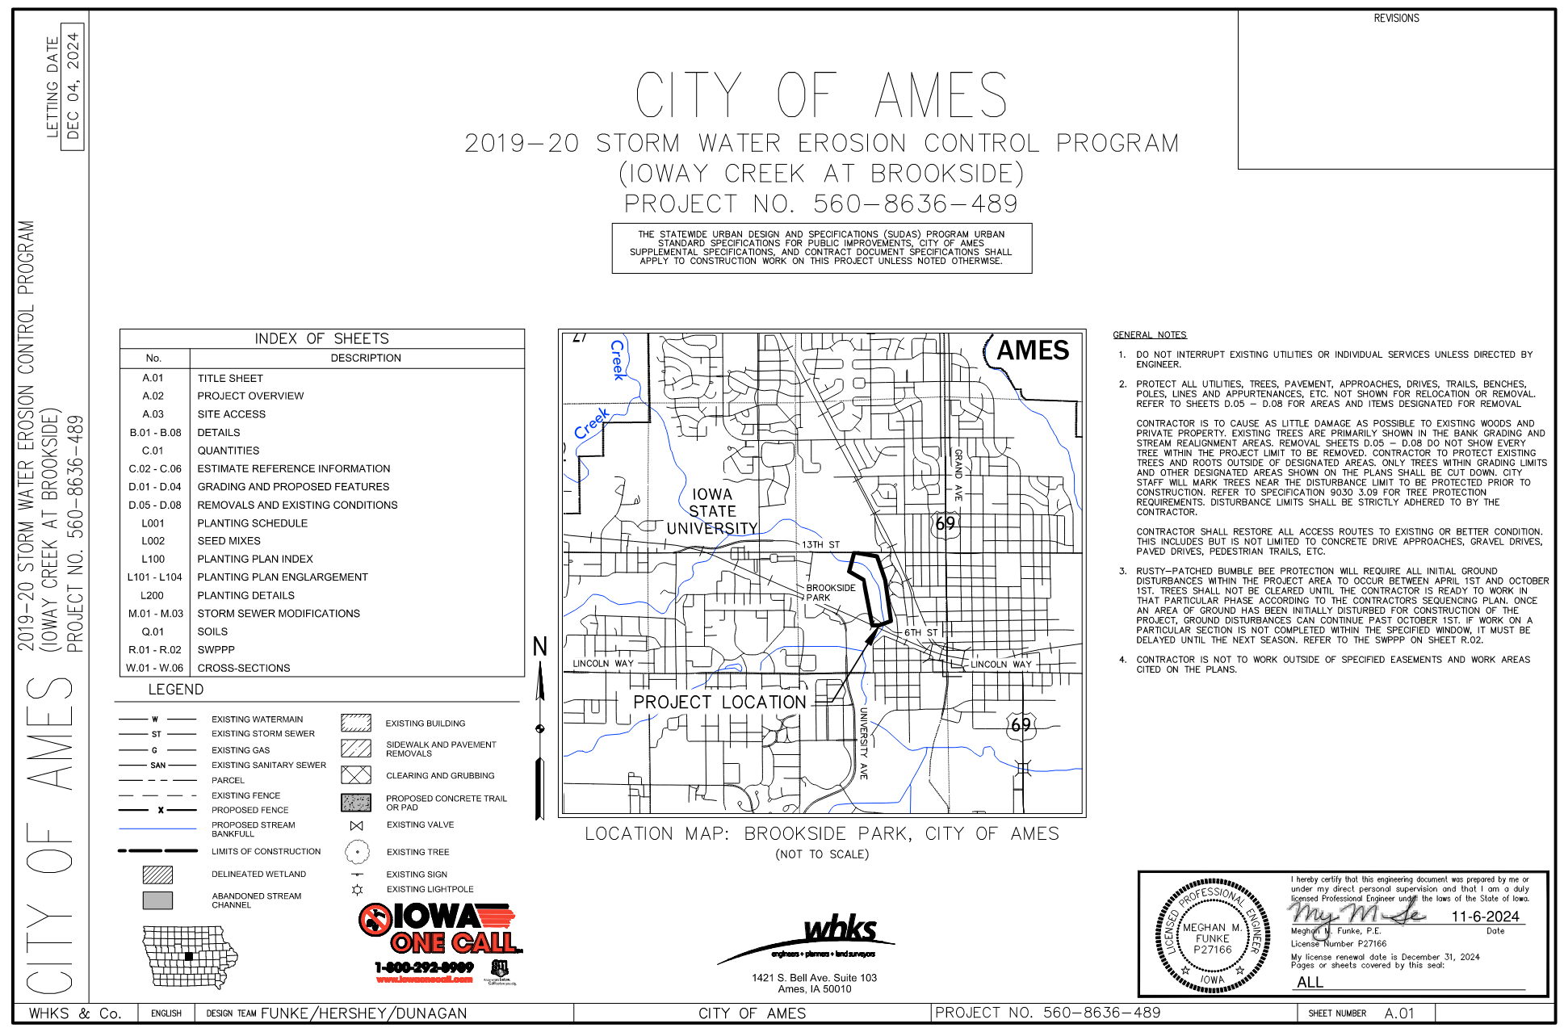
Iowa Creek at Brookside restoration

Slide 17
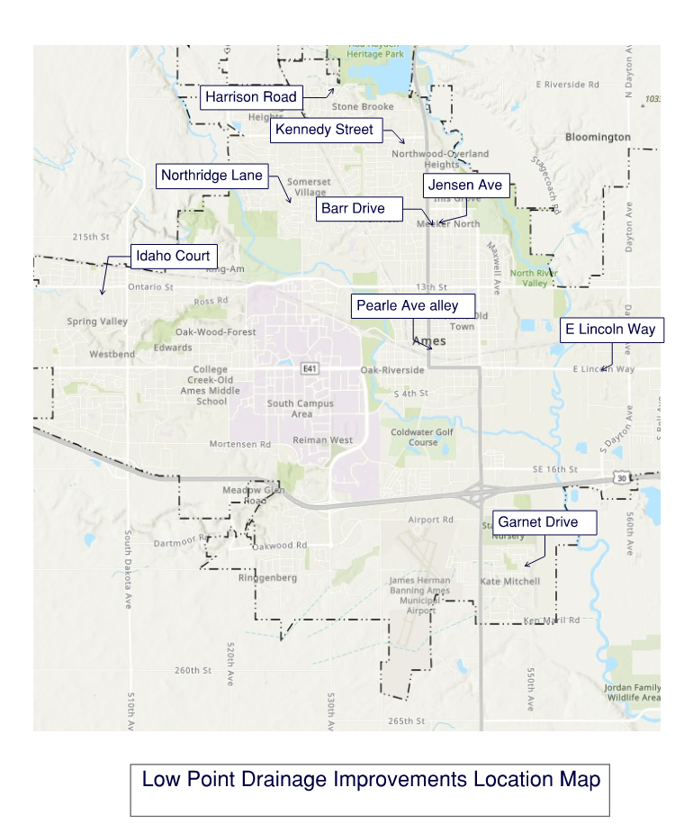
Low Point Drainage Improvement

Slide 18
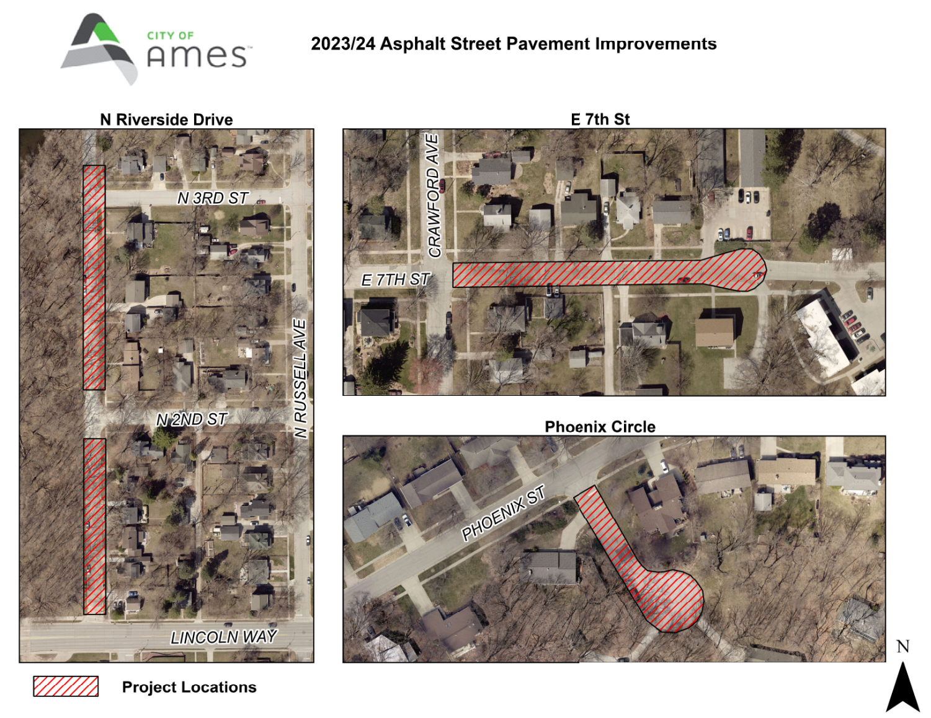
E 7th, N Riverside, phoenix circle Asphalt

Slide 19
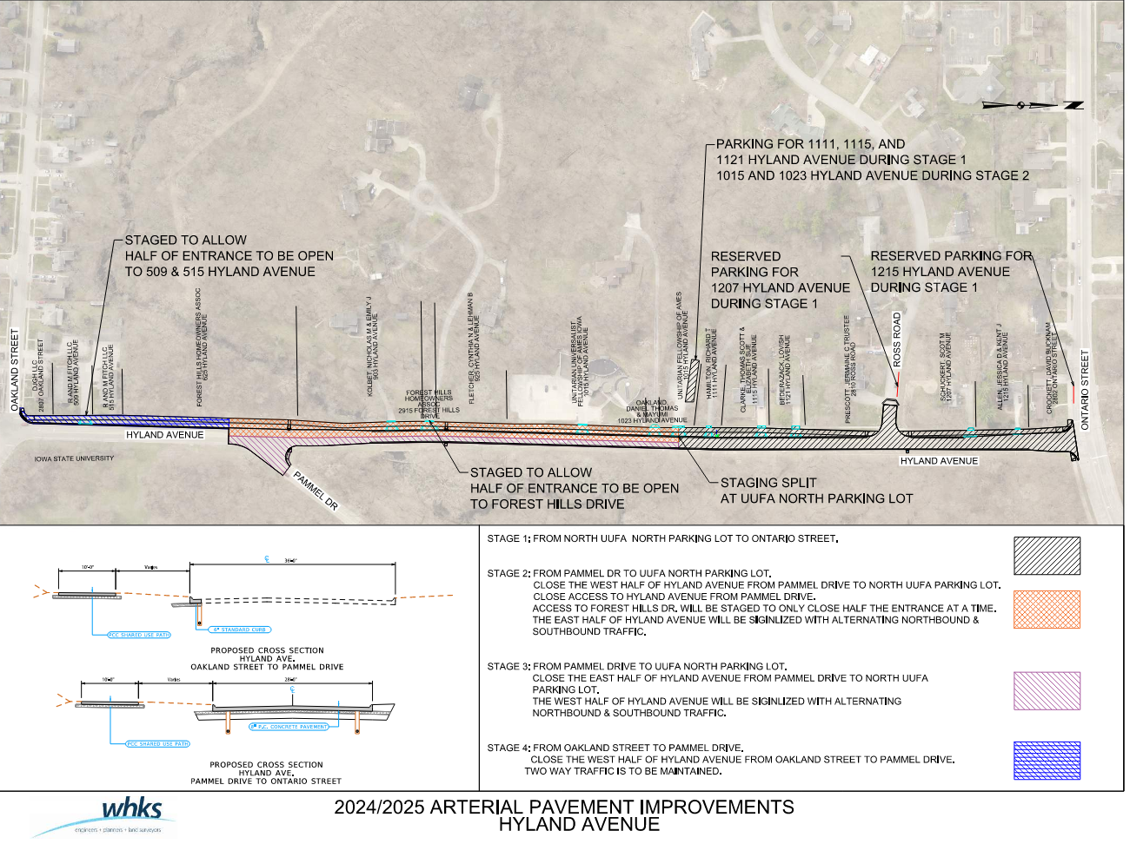
Hyland ave pavement improvements

Slide 20
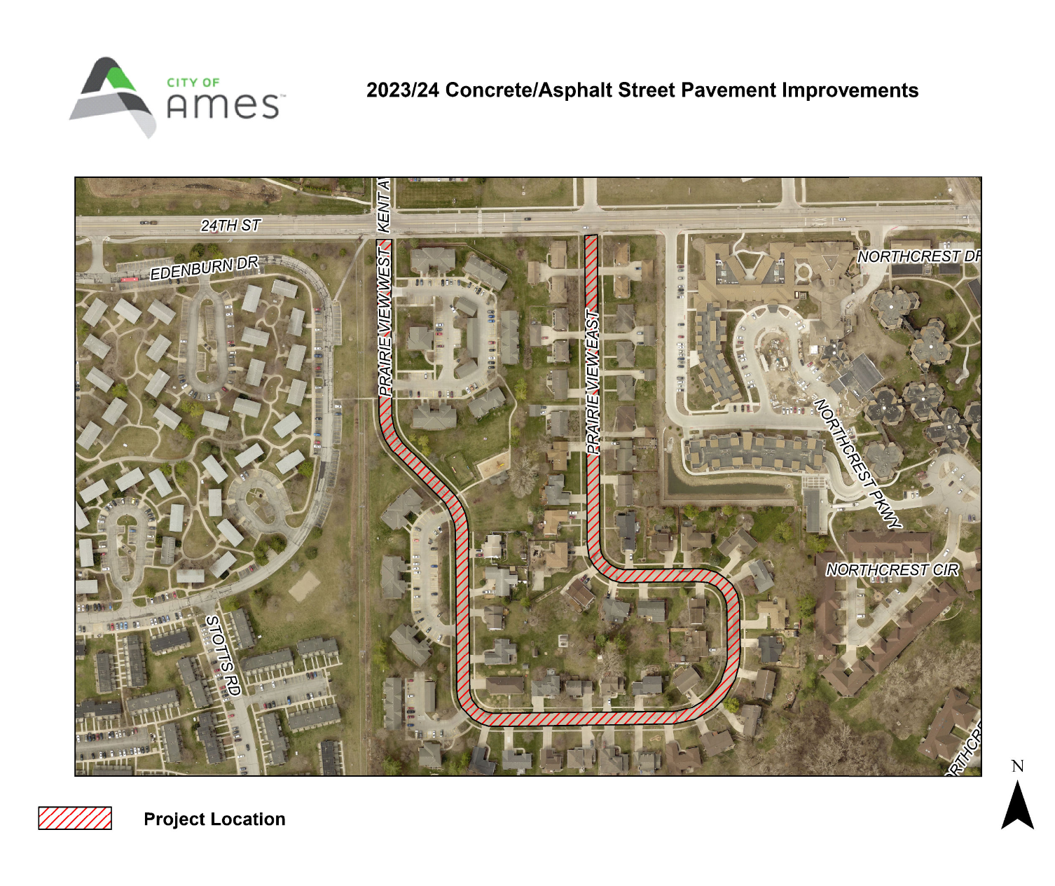
Prairie View East/west ST Pavement Improvements

Slide 21
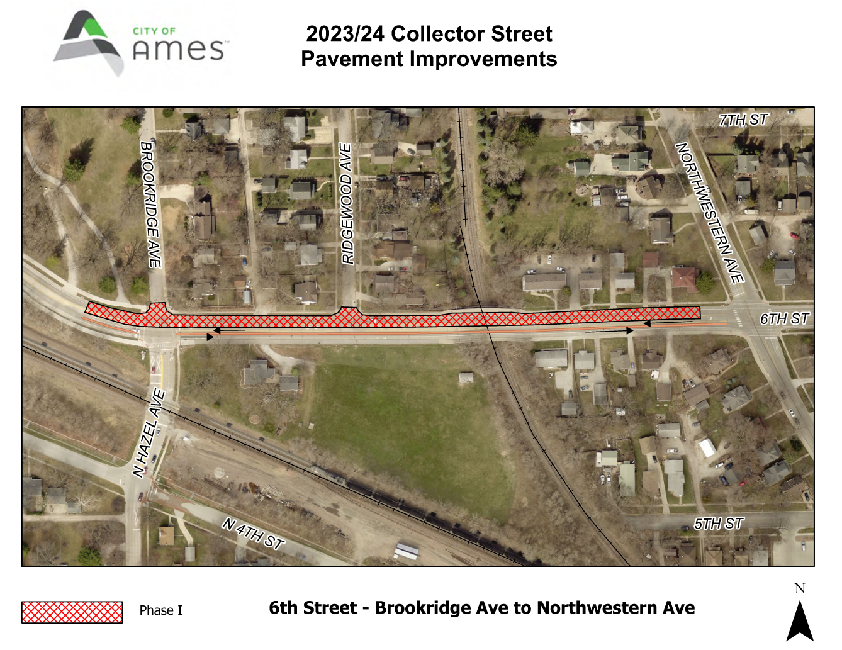
6th St Pavement Improvements

Slide 22
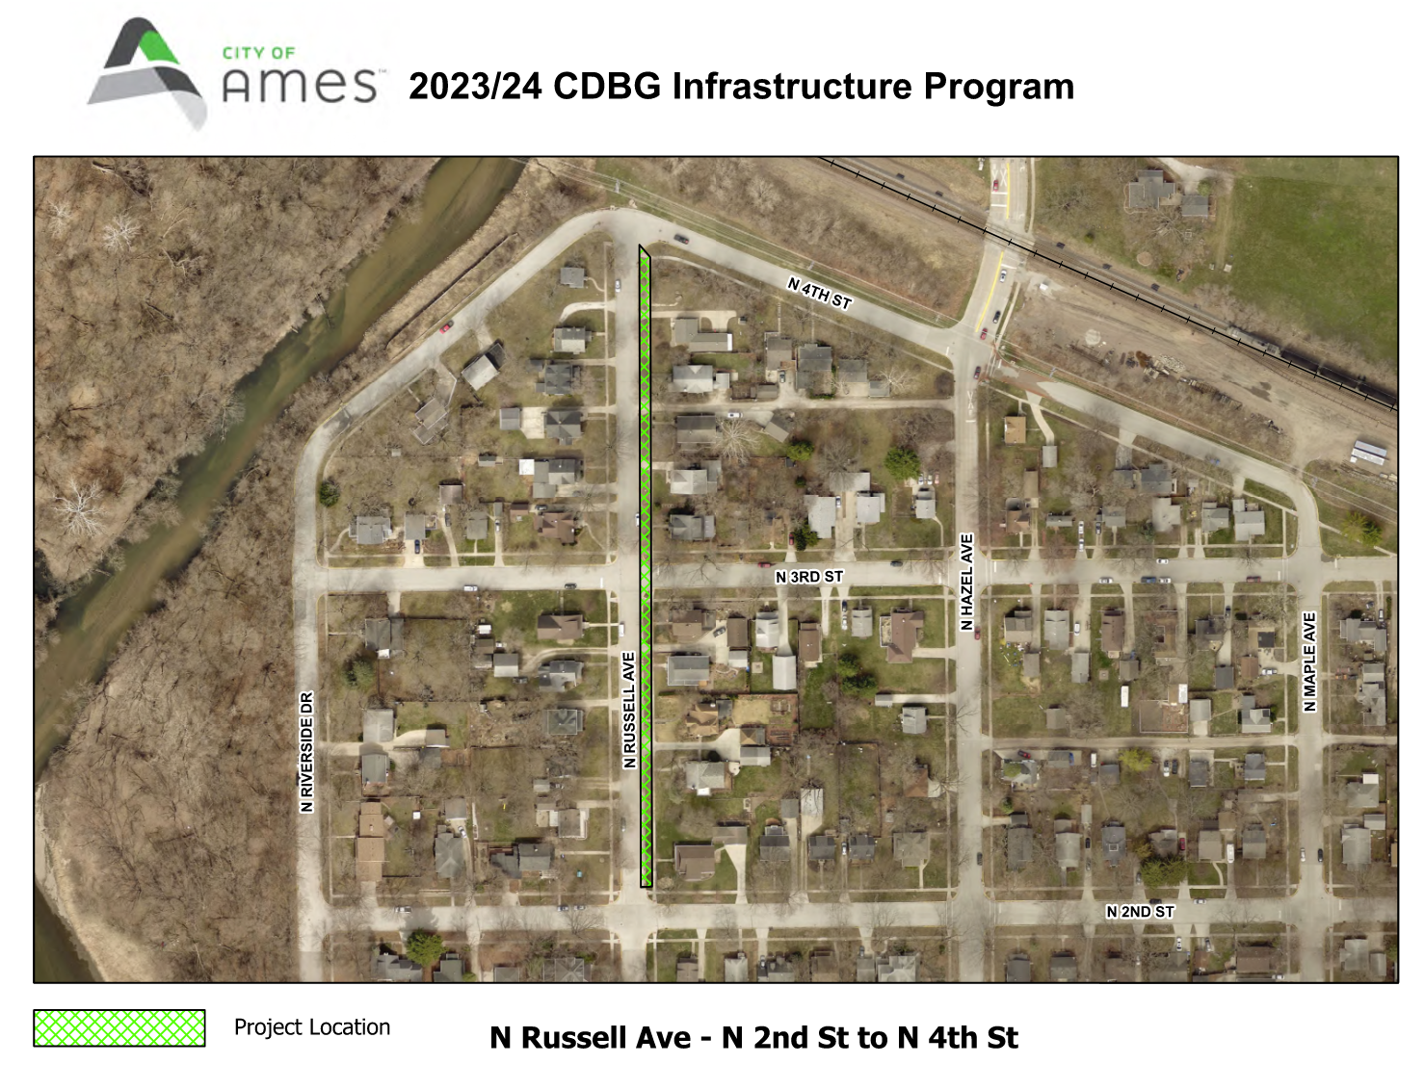
N Russell Ave Water Main Improvements

Slide 23
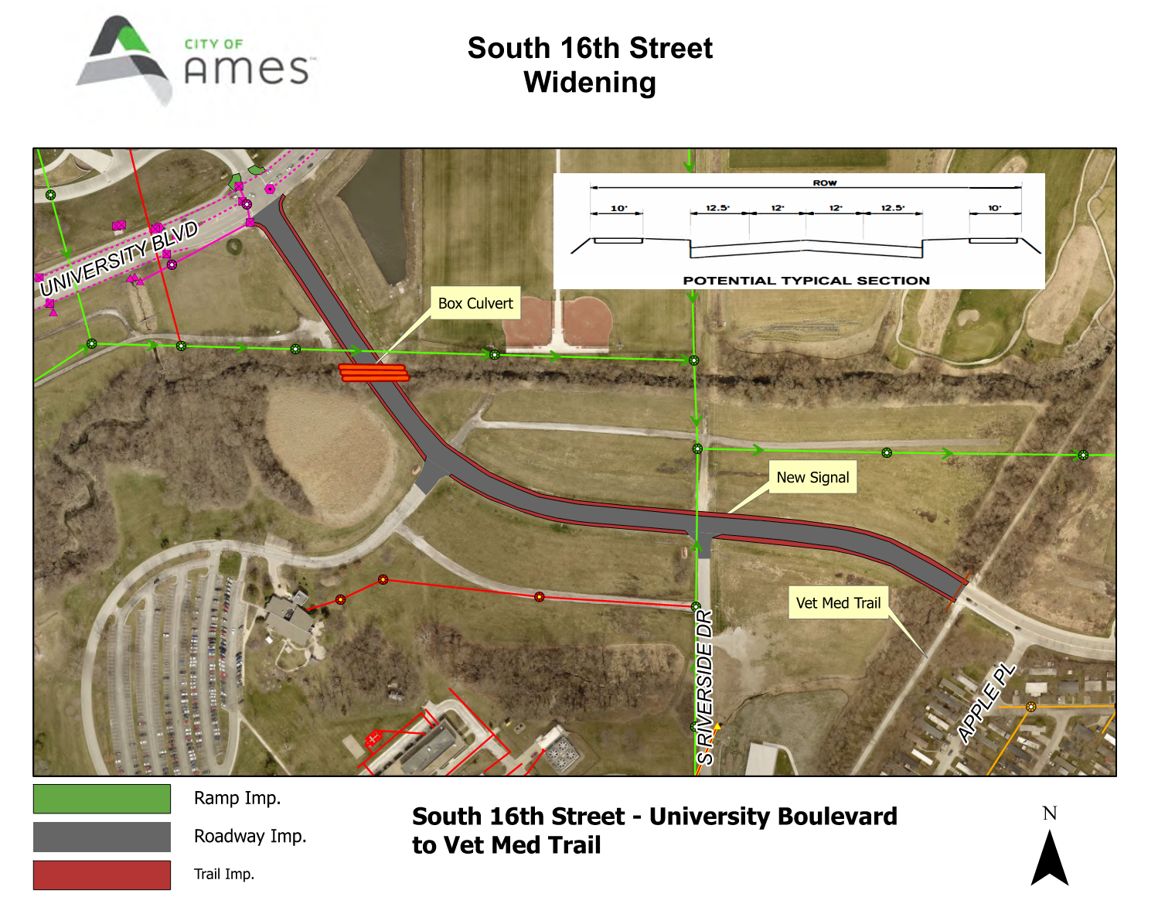
S 16th St widening

Slide 24
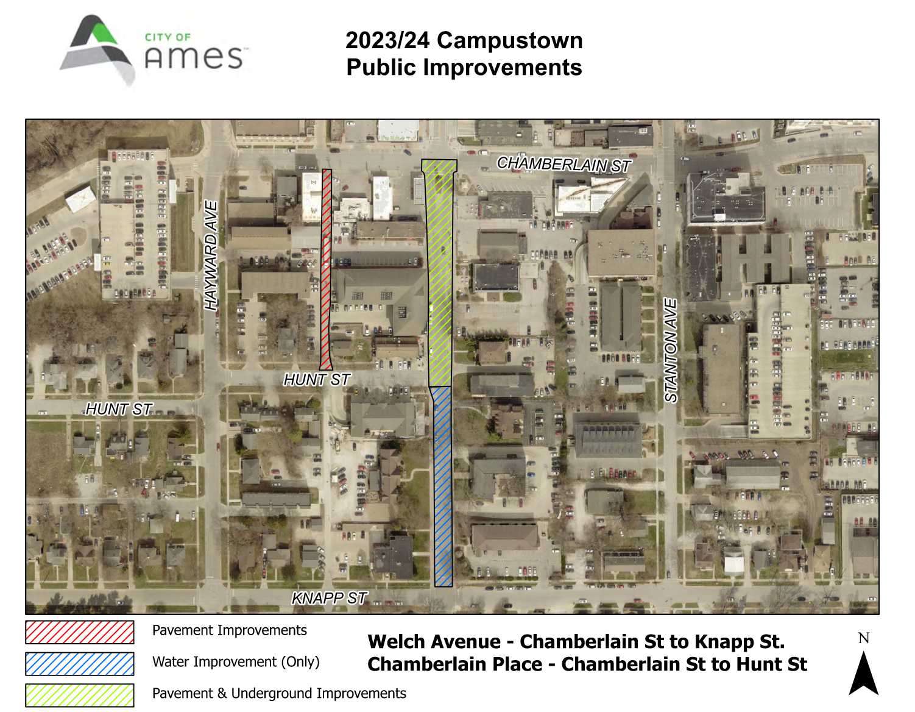
Welch Ave Public improvements

